Slide 1

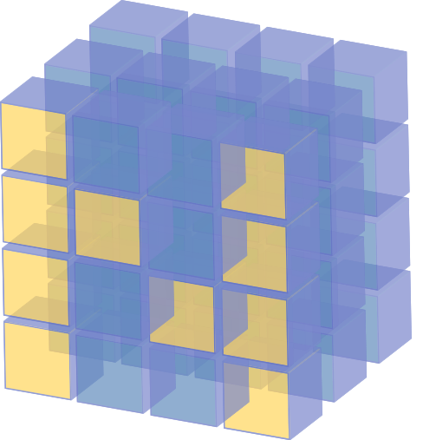
NumPy Function, Slice & Reshape in Python
Lecture-11

Slide 2
Contents
Universal functions
Indexing and slicing
Reshaping and transposing
sazzad@diucse

Slide 3
Universal Functions
NumPy offers dozens of standalone universal functions that perform various element-wise operations. Some of these functions are called when you use operators like + and * on arrays.
The NumPy documentation lists universal functions in five categories—math, trigonometry, bit manipulation, comparison and floating point.
Math | add, subtract, multiply, divide, remainder, exp, log, sqrt, power, and more.
Trigonometry | sin, cos, tan, hypot, arcsin, arccos, arctan, and more.
Bit manipulation | bitwise_and, bitwise_or, bitwise_xor, invert, left_shift and right_shift.
Comparison | greater, greater_equal, less, less_equal, equal, not_equal, logical_and,logical_or, logical_xor, logical_not, minimum, maximum, and more.
Floating point | floor, ceil, isinf, isnan, fabs, trunc, and more.
sazzad@diucse

Slide 4
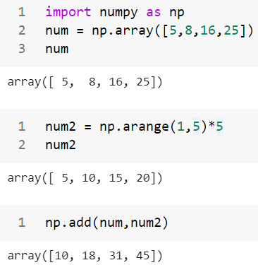
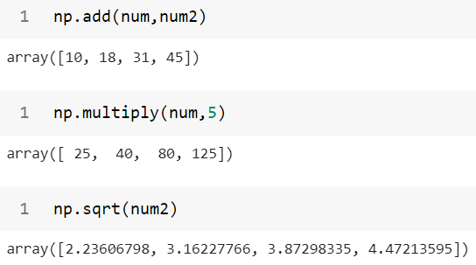
Universal Functions
Array Arithmetic Function
sazzad@diucse

Slide 5
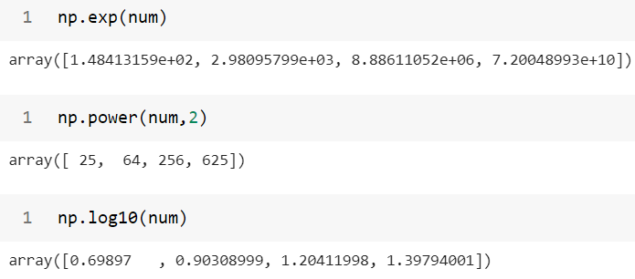
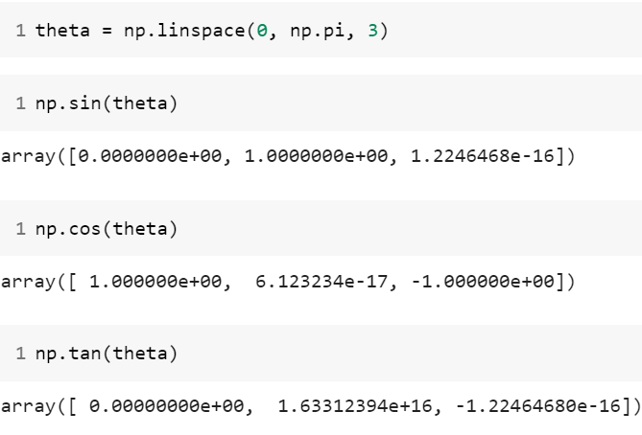
Universal Functions
Exponents and logarithms
Trigonometric functions
sazzad@diucse

Slide 6
Indexing and Slicing
Array element can access by referring to its index number.
The indexes in NumPy arrays start with 0, meaning that the first element has index 0, then second element has index 1 etc.
axis = 1
axis = 1
axis = 2
0
1
2
2
3
4
Index
0
1
2
2
3
4
2
3
4
axis = 0
0
2
5
6
7
3
4
Value
2
3
4
axis = 0
1
5
6
7
5
6
7
5
8
9
10
6
7
8
9
10
8
9
10
2
8
9
10
1D array
2D array
3D array
sazzad@diucse

Slide 7
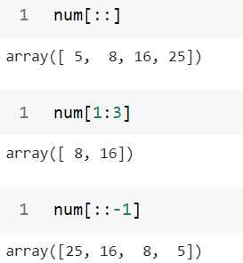
Indexing and Slicing
Slicing step describes the spacing between two values and is optional [start:stop] with a default value of 1. Negative values are supported (e.g [::-1] reverses the order).
Indexing with One-Dimensional arrays
sazzad@diucse

Slide 8
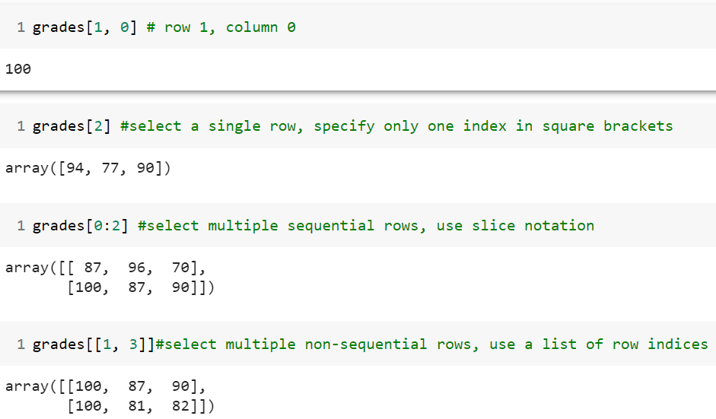
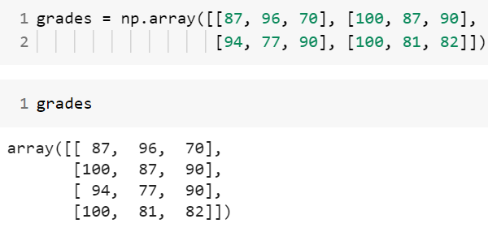
Indexing and Slicing
Indexing with Two-Dimensional arrays
sazzad@diucse

Slide 9
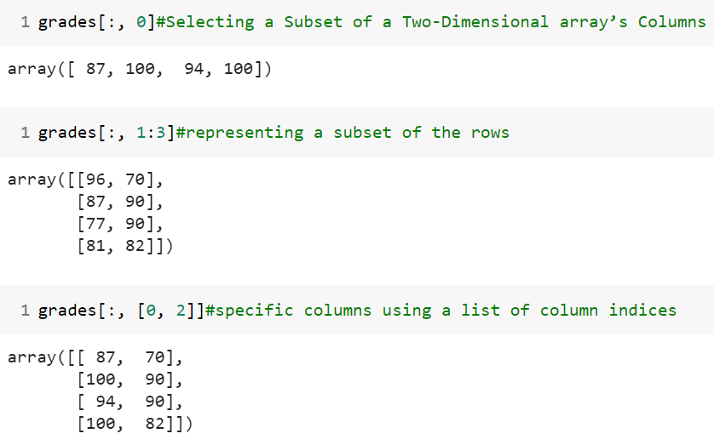
Indexing and Slicing
sazzad@diucse

Slide 10
Indexing and Slicing
Exercise :
Given the following array:
array([[ 1, 2, 3, 4, 5],[ 6, 7, 8, 9, 10],[11, 12, 13, 14, 15],[16,17,18,19,20])
a) Select the second row.
b) Select the first and third rows.
c) Select the middle three columns.
d) Show 12 and 13 from array.
e) Show reverse order of third rows values.
f) Select the fourth rows and find max, min, sum, mean, std and var of values.
g) Find log10, log2, log values of rows one.
sazzad@diucse

Slide 11
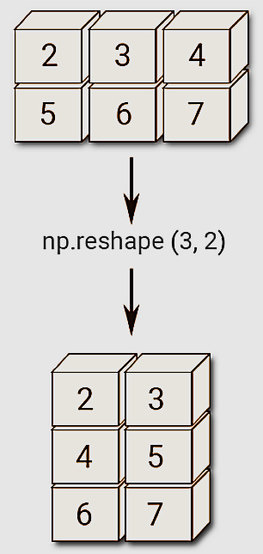
Reshaping
The reshape() function is used to give a new shape to an array without changing its data.
sazzad@diucse

Slide 12
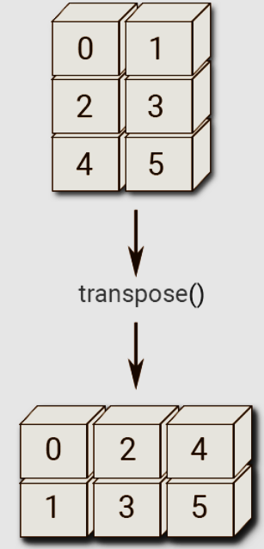
Transposing
Returns the transpose of a matrix.
If the matrix shape is (X,Y), then transpose matrix shape will be (Y,X). It switches the row and column indices of a matrix.
sazzad@diucse

Slide 13
Reshaping and transposing
Exercise:
Given a 3-by-4 array:
array([[[1, 3, 2,4],[8, 6, 5,7],[11,10,12,9]]])
Find transpose of given array.
Reshape the array.
Sort the array.
sazzad@diucse

Slide 14
Thank You
sazzad@diucse

